Slide 1
Logistic Regression
Data 100
Slides by John DeNero

Slide 2
Announcements

Slide 3
Classification

Slide 4
Classification
Classifiers are functions used to make predictions about a categorical variable.
Kevin Durant takes a 24-foot jump shot against the Celtics. Will it go in?
A 21-year-old white female from Florida is arrested for assault a second time. If let free, will she be arrested again for a violent crime in the next two years?
Typically, we pick a classification function using labeled training examples (x, y), then apply it to unlabeled examples x that we assume would be labeled similarly.
Potential problems:
Is the association between (x, y) in the training examples representative?
Are there enough training examples to estimate the association reliably?
How do you know whether the classification function will generalize?

Slide 5
Regression & Classification

Slide 6

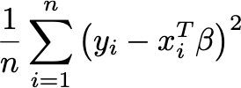
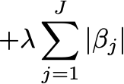
Linear Regression Review
Regression prediction problem: Predict outcome y from covariates (features) x.
Regression: Estimate E[Y|X] = f(X) for an unknown distribution over (X, Y).
Linear Regression: Assume E[Y|X] = X^{T}β and estimate β, a vector of parameters.
What’s the Model? The set of all distributions X^{T}β you can get by choosing β.
To Find Model Parameters: Choose a loss & regularization, then minimize risk.
Squared Loss for Linear Regression: (Y - X^{T}β)²
Empirical Risk: For training (i.e. learning) set of observations
Regularization: Add a term to the empirical risk that encourages small β.

Slide 7
Classification
(Demo)
Classification prediction problem: Predict y from features x.
But now, y must be chosen from a fixed set of possible classes, e.g., {in, out}.
Regression: Estimate E[Y|X] = f(X) for an unknown distribution P over (X, Y).
Let’s assign numbers to the classes, e.g., in is 1 and out is 0, then
Classification: Estimate P(Y=1|X) = f(X) for an unknown distribution P over (X, Y), assuming Y is categorical and binary with value 0 or 1.
Linear Regression: Assume E[Y|X] = X^{T}β and estimate parameters β.
Logistic Regression: Assume P(Y=1|X) = σ(X^{T}β) and estimate parameters β.
What is that and why is it there?

Slide 8
Classification by Logistic Regression
(Demo)
Binary Classification Prediction: Predict y∊{0,1} from covariates (features) x.
Binary Classification: Estimate P(Y=1|X) = f(X) for unknown distribution over (X, Y).
Logistic Regression: Assume P(Y=1|X) = σ(X^{T}β) and estimate β; σ(t)=1/(1+exp(-t)).
To Find Model Parameters: Choose a loss & regularization, then minimize risk.

Slide 9
Summary: Why Not Squared Loss for Logistic Regression?
Squared loss is not a terrible choice; it is often used in practice (or used to be).
However, the corresponding empirical risk function can be non-convex, and therefore difficult to minimize.
Loss is bounded because y and σ(x^{T}β) are both in the interval [0, 1].
Cross-entropy loss has other motivations that you can learn about in a machine learning or probability course: maximum likelihood or minimum KL-divergence.

Slide 10
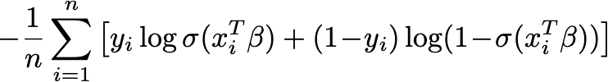
Classification by Logistic Regression Using Cross-Entropy Loss
Binary Classification Prediction: Predict y∊{0,1} from features x.
Binary Classification: Estimate P(Y=1|X) = f(X) for unknown distribution over (X, Y).
Logistic Regression: Assume P(Y=1|X) = σ(X^{T}β) and estimate β; σ(t)=1/(1+exp(-t)).
To Find Model Parameters: Choose a loss & regularization, then minimize risk.
Cross-Entropy Loss for Logistic Regression: -(Y log σ(X^{T}β) + (1-Y) log (1-σ(X^{T}β)))
Empirical Risk: For training (i.e. learning) set of observations
Regularization: Add a term to the empirical risk that encourages small β.

Slide 11
Logistic Regression
(Demo)

